Slide 1


Geometric structures for statistical models in ML: ∼ An overview with some recent results for ML ∼
Frank Nielsen
Sony Computer Science Laboratories, Inc.
OIST ML Workshop
3rd March 2025
Notes:
https://omlw2025.mlds.jp/
Fisher-Rao and Bregman manifolds: Some Applications in Machine Learning
Divergences and information geometry in machine learning

Slide 2
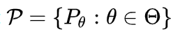
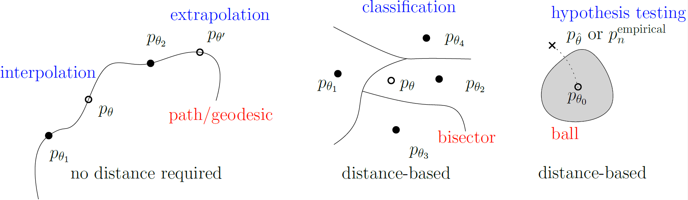
Which geometric structures for statistical models?
model
evolution
Mid distribution
information fusion
Voronoi diagrams
Information
projection
Some benefits of the geometric approach:
foster geometric intuition & creativity!
leverage most advanced geometric calculus with coordinate-free tensors
may get exact geometric characterization when non-closed algebraic formula
obtain new pure geometry for mathematics: dual statistical structures

Slide 3


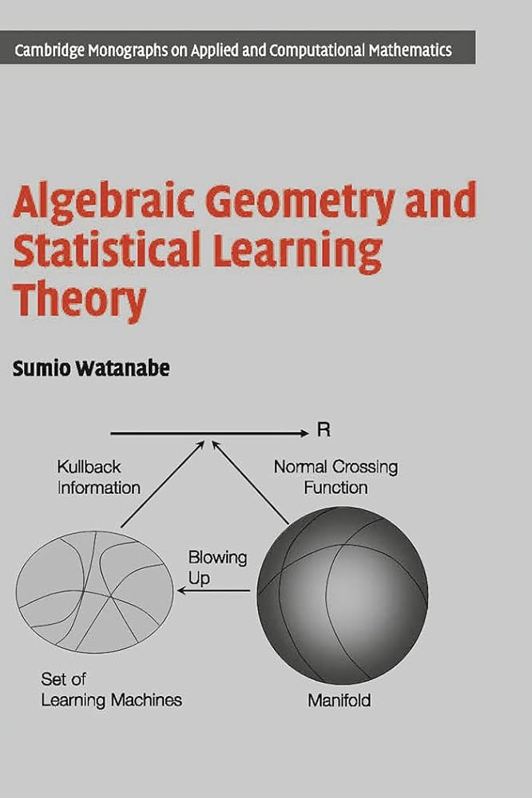
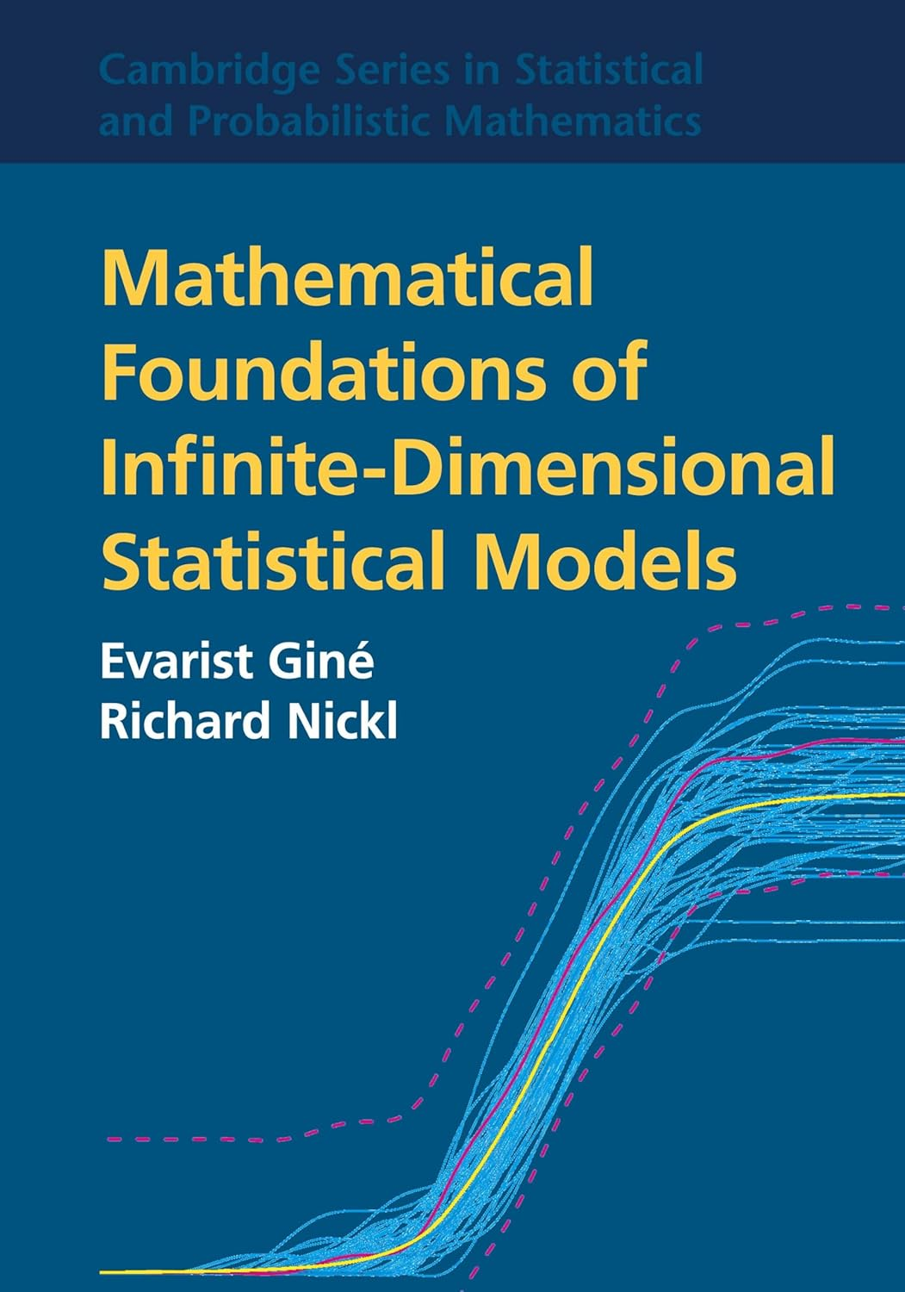

Geometric structures of statistical models & uses?
Geometry of
domains Θ/manifolds
Geometry of
regular statistical models
statistical manifolds
Geometry of singular
hierarchical models
(mixtures, DNNs)
Non-parametric
statistical models
and many more!!!
Geometry of
convex functions
Dual α-geometry of
statistical models/divergences
Algebraic geometry
resolving singularities
Function spaces
(approximations)
Model identifiability:

Slide 4
Outline
Overview of three geometric structures for the statistical models of
normal distributions and categorical distributions with applications:
Fisher-Rao manifolds & numerical Fisher-Rao Gaussian distances
Hilbert geometry & fast distances between multivariate Gaussians
Bregman manifolds and some usages for statistical models:
The family of categorical distributions view either as:
A mixture family manifold : Jensen-Shannon centroid
An exponential family manifold: Chernoff information/Chernoff point

Slide 5
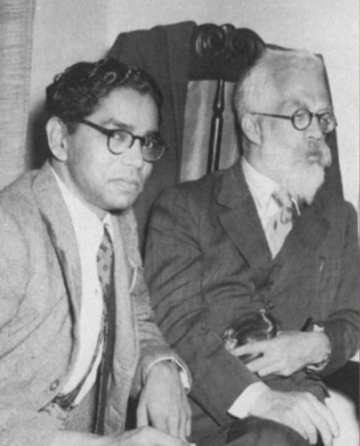
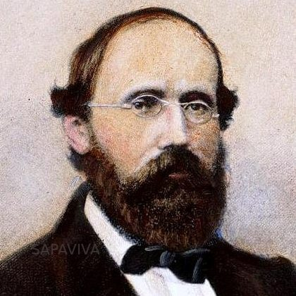
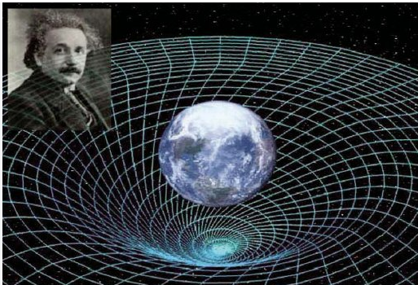

Fisher-Rao manifolds Riemannian geometry
In the beginning…
[Hotelling 1930, Rao 1945]
Photo 1956
Length element
ds
``Killer’’
application
1854
1915, GR

Slide 6
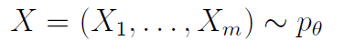

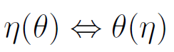

Fisher-Rao manifolds
Manifold viewpoint: Parameter space Θ interpreted as a global coordinate chart of a manifold M (vs general case in geometry)
Fisher metric: Consider Fisher information matrix of statistical models as metric tensor* field g in θ-coordinate system
Metric tensor g(.,.) provides a way to measure vector lengths, angle between vectors (orthogonality)
Length element is independent of parameterization:
Fisher-Rao distance is length* of shortest path ( = Riemannian distance): integrate length element along Riemannian geodesic
Metric distance satisfying the triangular inequality
Notes:
Intrinsic vs extrinsic view (surfaces in Euclidean) of Riemannian manifolds

Slide 7
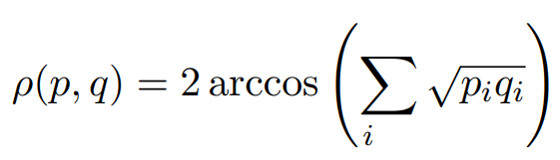
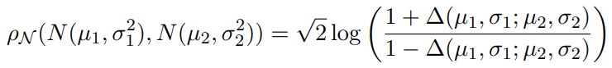
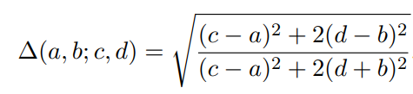
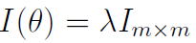
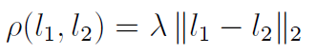
Fisher-Rao distances: Curvatures in Statistics
Riemannian modeling (M=P_{Θ},g_{Fisher}) allows to define various curvature notions: sectional curvatures (4D Riemann-Christoffel curvature tensor, Ricci curvature tensor, Ricci scalar tensors, etc.)
Example 1 : Family of categorical distributions with m+1 choices
Example 2 : Family of univariate normal distributions (m=2)
Example 3 : location families*
m-dim location parameter l
Positive sectional curvatures:
spherical geometry
Negative sectional curvatures:
hyperbolic geometry
Zero sectional curvatures:
Euclidean geometry

Slide 8
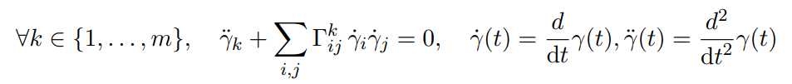
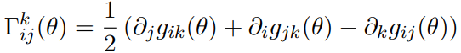
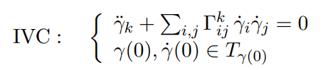
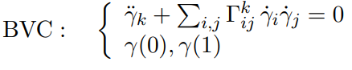
Problem: Tractability of Fisher-Rao geodesics/distances
Need (1) to solve geodesic ODE equation
and (2) integrate length element along the geodesic
Solve geodesic ODE either with initial value conditions (IVC) or with boundary value conditions (BVC)
Christoffel symbols:
derived from metric tensor g

Slide 9
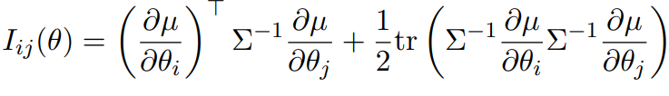
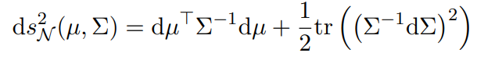
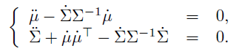
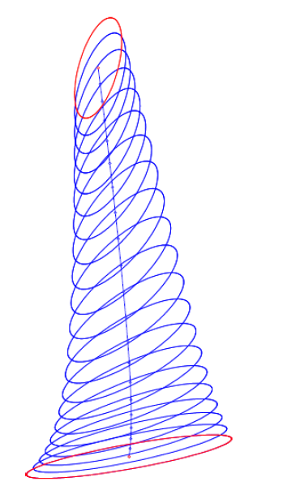
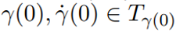
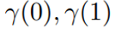
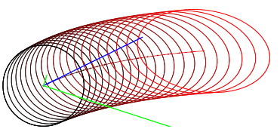
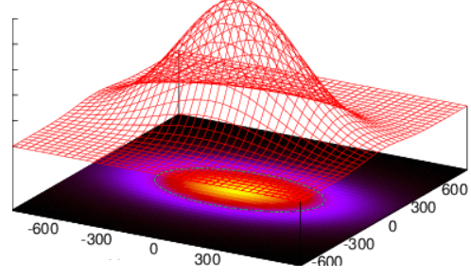
Tractability of Fisher-Rao distance:
Yet the open case of the multivariate normal family!
Fisher length:
Solve ODE with
initial values (IV) or
boundary values (BV)
Geodesic ODE:
Non-constant sectional curvatures which can also be positive!
(geodesics are always unique when negative sectional curvatures)
[IV: Eriksen 1987]
[BV: Kobayashi 2023]
Bivariate normal
(represented by ellipsoids)

Slide 10
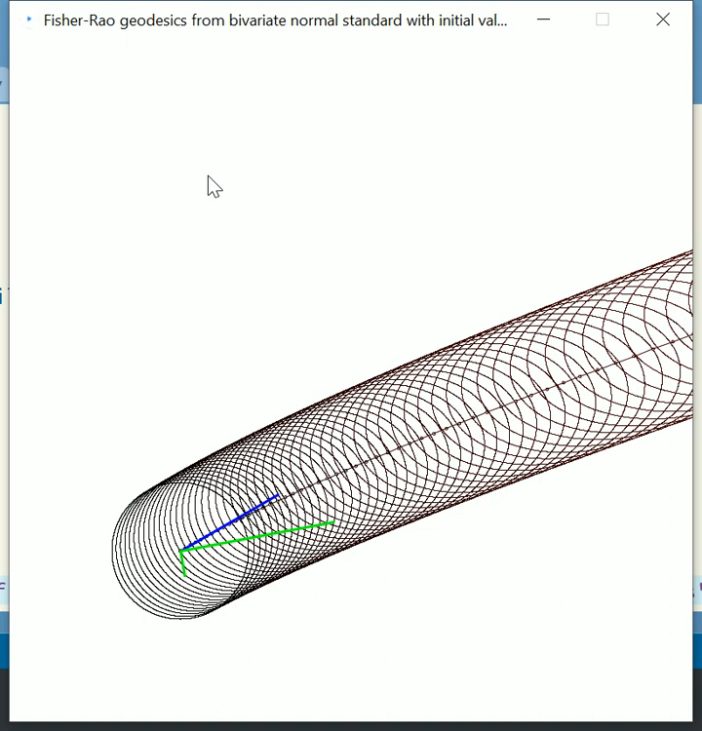
Fisher-Rao geodesics with initial values emanating from the standard bivariate Gaussian
Blue vector is initial tangent vector for μ₀
Green vectors are the 2 eigenvectors of the
initial tangent vector for Σ₀ , symmetric matrix
[IV: Eriksen 1987]

Slide 11
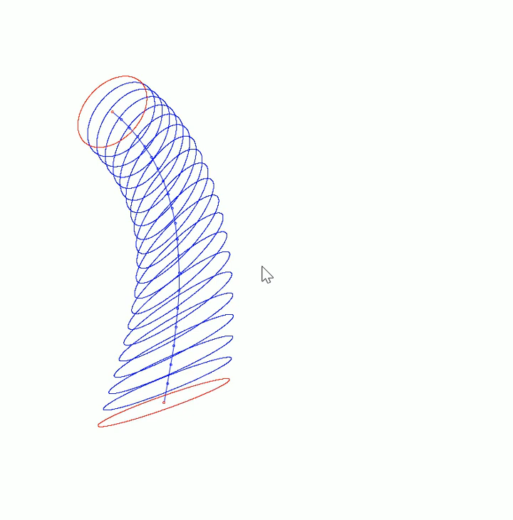
Fisher-Rao geodesics with boundary
Red ellipsoids are the boundary conditions:
That is bivariate normal distributions
(μ₀,Σ₀) and (μ₁,Σ₁)
[BV: Kobayashi 2023]
Technically, MVN Fisher-Rao geodesic:
Riemannian submersion of a horizontal geodesic
of a Riemannian symmetric space in 2d+1 dimension

Slide 12


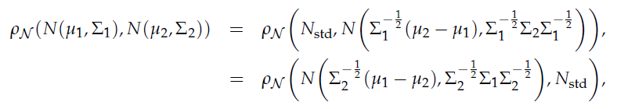
No known closed-form for Fisher-Rao between multivariate normal distributions
May always consider distance to standard normal distribution
because of the invariance under action of the positive affine group:
In general, hard to prove uniqueness of geodesics when some sectional curvatures are positive: The case of MVN Fisher-Rao manifold!!!
Hence, we have

Slide 13
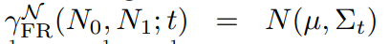
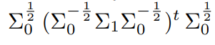
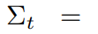
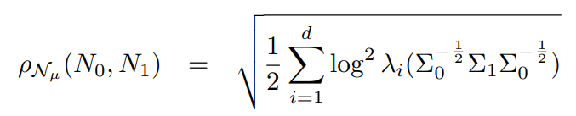
Special case: Centered multivariate normals Closed form geodesics and Fisher-Rao distances
Submanifold of MVNs with constant mean is totally geodesic
Fisher-Rao geodesics:
[James 1973]
[Siegel 1964]
Fisher-Rao distance:
Require to compute all eigenvalues (costly)
Because of sum of log² , we have
ρ(P₁,P₂)=ρ(P₁⁻¹,P₂⁻¹) : invariance to matrix inversion

Slide 14
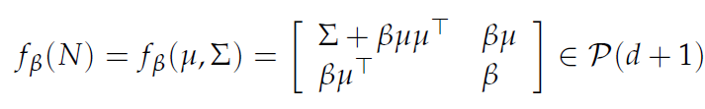
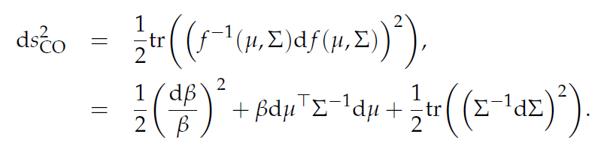
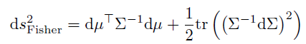
Embedding manifold Gaussian/MVN(d) onto SPD(d+1)
[Calvo & Oller 1990]
The diffeomorphisms {f_{β}} foliates the SPD cone P(d+1)
Using 1/2 trace metric in P(d+1), get the following metrics on MVN(d):
β=1
When β=1 (constant), get Fisher isometric embedding of MVN(d) into SPD(d+1):

Slide 15
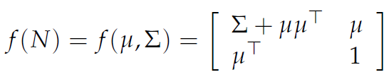
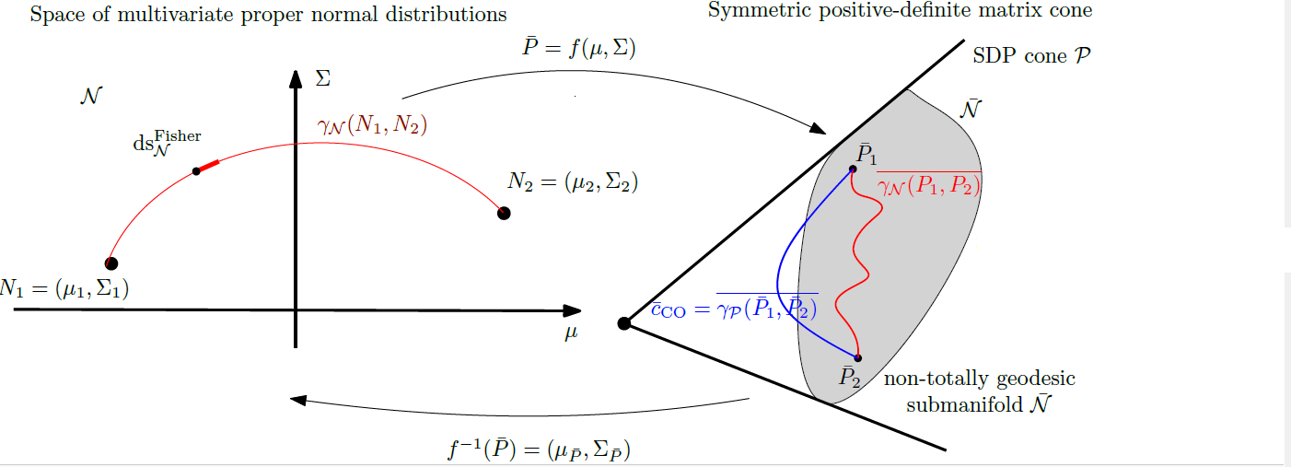
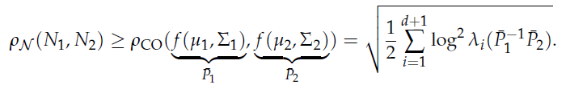
Fisher-Rao MVN distance: A lower bound
Embed isometrically the Gaussian manifold N(d) into a submanifold
of codimension 1 into the SPD cone of dimension d+1 but non-totally geodesic:
Use SPD geodesic in the (d+1)-dimensional cone:
SPD path is of length necessarily smaller than the MVN geodesic
in submanifold f(N). Thus get a lower bound on Rao distance:
[Calvo & Oller 1990]
Cut MVN geodesics and apply lower bound piecewise : Get fine lower bound!

Slide 16

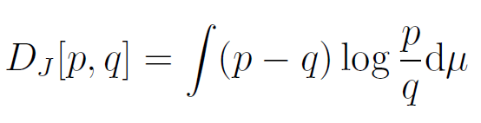

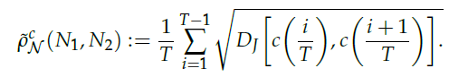
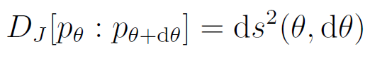
Fisher-Rao MVN distance: An upper bound
Geodesics are 1d totally geodesic submanifolds
Cut the geodesics in many small parts using T+1 geodesic points
Upper bound for nearby points Fisher-Rao distance by the square root of Jeffreys divergence
Fine upper bound!

Slide 17
(1+ε)-approximation of Fisher-Rao distance between multivariate normal distributions
ApproxRaoDistMVN(N0,N1,ε>0): // multiplicative factor
LB=CalvoOllerLowerBound(N0,N1);
UB=SqrtJeffreysUpperBound(N0,N1);
if (UB/LB>1+ε)
{/* N is midpoint geodesic */
N=GeodesicMVNMidpoint(N0,N1);
return ApproxRaoDistMVN(N0,N,ε)+ApproxRaoDistMVN(N,N1,ε);}
else
return UB;
2403.10089
Then we can convert multiplicative approximation factor by an additive approximation factor

Slide 18
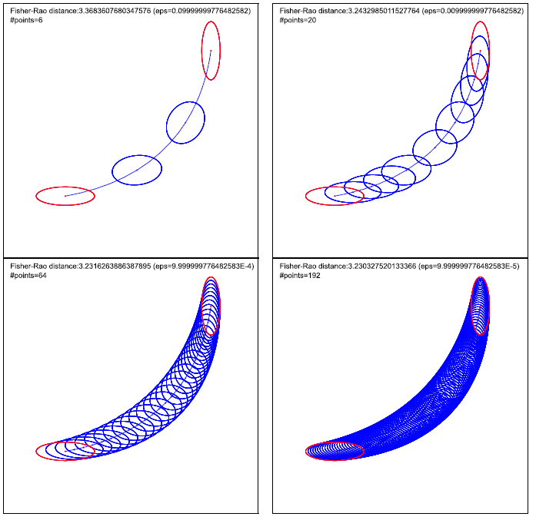
Precision ε=10⁻⁶ with
192 geodesic discretization steps
Implemented
in library pyBregMan
python Bregman Manifold
Thus MVN Fisher-Rao distance can
be finely approximated with guarantees
but slow…
Other MVN fast distances?
https://franknielsen.github.io/pyBregMan/index.html

Slide 19
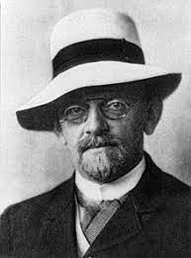
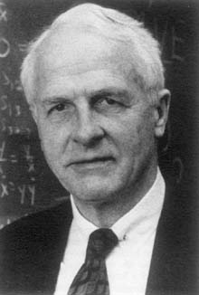
Hilbert geometry & Birkhoff cone geometry Projective/Finsler geometry of convex domains
2203.11434
ICML TAG-ML 2023

Slide 20
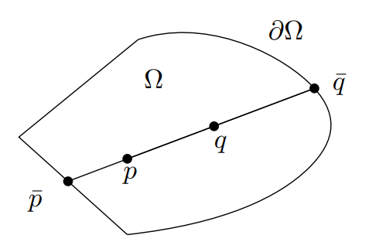
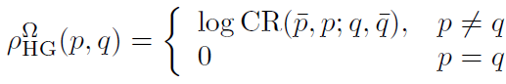
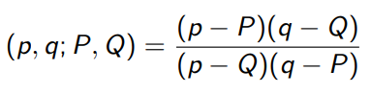

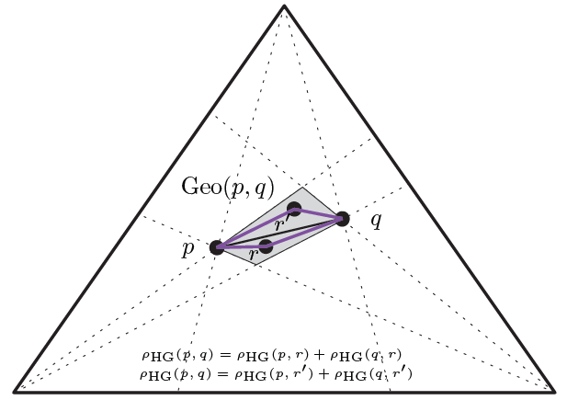
Hilbert distance: The log cross-ratio metric
Consider an open bounded convex set Ω
Cross-ratio CR
ρ^{Ω} is a metric distance which satisfies the triangle inequality:
Straight lines are geodesics
=satisfying triangle equality
but geodesics are not unique
For example:
open standard simplex

Slide 21
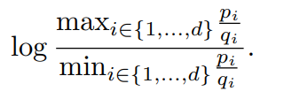



Hilbert geometry on the probability simplex: Balls have hexagonal Euclidean shapes
Fast to compute
Only when domain is a simplex,
Hilbert geometry amounts
to a normed vector space
with polyhedral norm (hexagonal metric)
Hilbert simplex geometry
Poly. norm vector space
2203.11434

Slide 22








Birkhoff: Hilbert projective distance in a cone
Cone:
Cone defines a partial ordering:
Birkhoff distance:
where
Birkhoff projective distance:
which becomes the Hilbert metric distance on Ω:
Notes:
$$
C=\{(\lambda ,x) \st \lambda\in\bbR_{>0}, x\in\Omega\}
$$
$$
p \preceq_C q \Leftrightarrow q-p\in C
$$
$$
M(p,q)=\inf\{\lambda\in\bbR_{>0} \st p \preceq_C \lambda q\}
$$
$$
m(p,q)=\sup\{\lambda\in\bbR_{>0}\st \lambda q\preceq_C p\}
$$
$$
\rho^C_\HG(p,q)=\log\frac{M(p,q)}{m(p,q)}
$$
$$
\rho^C_\HG(p,q)=\rho^C_\HG(\alpha p,\beta q), \quad\alpha,\beta>0
$$
$$
\rho^\Omega_\HG(p,q)=\rho^C_\HG(p,q),\quad \forall p,q\in\Omega
$$

Slide 23



New fast distances between multivariate normals
Use Calvo & Oller’s diffeometric/isometric cone embeddings f(μ,Σ)
Gaussian(d) manifold
Hilbert geometry
SPD(d+1) cone

Slide 24



New fast distance between multivariate normals
Use Calvo & Oller isometric cone embedding f(μ,Σ)
In SPD cone, Hilbert projective metric distance
Pullback the geodesics and distance into the Gaussian manifold
Projective metric on SPD
But proper metric on f(N)
LERP pregeodesics
Straight line edge!

Slide 25




Pullback Hilbert distance/geodesics between MVNs
Only require to calculate 2 extreme eigenvalues (power method iteration)
Hilbert-Fisher-Rao distance

Slide 26
Comparisons Fisher-Rao vs Fisher-Rao-Hilbert geodesics
Boundary conditions
Fast Fisher-Rao-Hilbert distance (extreme SPD matrix eigenvalues)
Slow guaranteed Fisher-Rao distance

Slide 27
Bregman manifolds: Geometry of convex conjugates Dual Hessian geometry
[Koszul’64, Shima’70’s, Amari&Nagaoka’80’s]

Slide 28





Bregman divergence (1960’s)
Let F: Θ⊆ℝ^{m}→ℝ be a strictly convex and smooth
real-valued function on a Hilbert space <.,.>
Bregman divergence B_{F}: Θ x Int(Θ) →ℝ
Lev M. Bregman
(1941 - 2023)
Photo: courtesy of
Alexander Fradkov
B_{F}(θ₁ : θ₂)=F(θ₁)-F(θ₂)-< θ₁ - θ_{2 ,} ∇F(θ₂) >
Popular in geometry, information theory, signal/sound processing!
Unify squared Euclidean divergence with Kullback-Leibler divergence F(θ)= Σ_{i} θ_{i} log(θ_{i}) and Itakura-Saito divergence F(θ)= Σ_{i} -log(θ_{i}).
The L22, KLD and ISD belong to a single family of β-divergences, learn β
Notes:
https://en.wikipedia.org/wiki/Mathematical_operators_and_
ℝ
symbols_in_Unicode
Θθ∇≻ξ∈
http://lib.physcon.ru/doc?id=5d34ad008433
Σ
Lev Meerovich Bregman
(1941 - 2023)

Slide 29

Bregman divergences in machine learning…
Kullback-Leibler divergence between two probability densities:
D_{KL}[p(x):q(x)]= ∫ p(x) log (p(x)/q(x)) dμ(x)
difficult to calculate in closed form because of the integral ∫ …
But the Kullback-Leibler divergence between two probability densities of an exponential family like Gaussian, Poisson, Dirichlet, Gamma/Beta, Wishart
amount to a reverse Bregman divergence B_{F}^{rev}(θ₁ : θ₂):= B_{F}(θ₂ : θ₁)
D_{KL}[p(x|θ₁) : p(x|θ₂) ]=B_{F}^{rev}(θ₁ : θ₂)= B_{F}(θ₂ : θ₁)
⇒ Easy calculations
Notice divergence between parameters B_{F} vs divergence between functions KL
p(x| θ) ∝ exp(<x, θ >)
Bypass the ∫, ∇F easy!
Azoury, Katy S., and Manfred K. Warmuth. "Relative loss bounds for on-line density estimation with the exponential family of distributions." Machine learning 43 (2001)
Notes:
∫μ
∇F easy!
Information geometry proves that B_{F}(θ₁ : θ₂)= D_{KL}*[p(x|θ₁) : p(x|θ₂) ]
when F(θ)=log ∫ exp(<x, θ >) dμ(x) where D_{KL}*[p(x):q(x)]:= D_{KL}[q(x):p(x)] is the reverse Kullback-Leibler divergence

Slide 30
Convex duality via Legendre-Fenchel transform
Legendre-Fenchel transform of a convex function F:
F*(η)=sup _{θ ∈ ϴ} {< θ, η >-F(θ)}
Consider “nice convex functions” = Legendre-type functions (ϴ,F(θ)) :
(i) ϴ open, and (ii) lim _{θ→ ∂ϴ} ‖ ∇F (θ) ‖=∞
Then we get:
❶ reciprocal gradient maps η= ∇F (θ) and θ=∇F* (η), ∇F*=(∇F)⁻¹
❷ conjugation yields (H,F*(η)) of Legendre type
❸ biconjugation is an involution: (H,F*(η))*= (H*=ϴ,F**=F(θ))
Convex conjugate: F*(η)= < ∇F⁻¹ (η), η >-F(∇F⁻¹(η)) since η= ∇F (θ)
Notes:
η → ‖ ∞

Slide 31


Duo Bregman divergences: Generalize BDs with a pair of generators
One generator majorizes the other one:
F₁(θ) ≥ F₂(θ)
Then
B_{F1,F2}(θ’’:θ’’)
≥ B_{F}(θ: θ’)
θ’’
Recover Bregman divergence when F₁(θ) = F₂(θ) = F(θ)
Only pseudo-divergence because B_{F1,F2}(θ’’: θ’’) positive, not zero
B_{F}(θ₁ : θ₂)=F(θ₁)-F(θ₂)-< θ₁ - θ_{2 ,} ∇F(θ₂)>
Notes:
≥ B_{F}(θ: θ’)

Slide 32
KLD between nested exponential families amount to duo Bregman pseudo divergences
q(x| θ)» p(x| θ)
p(x| θ)
X₁
X₂
q(x| θ)
Consider an exponential family on support X₁:
p(x| θ) = exp(<x, θ >-F₁(θ)) dμ(x)
with cumulant function F₁(θ)=log ∫_{X1} exp(<x, θ >) dμ(x)
Another exponential family with nested supports: X₁ ⊆ X₂
q(x| θ) = exp(<x, θ >-F₂(θ)) dμ(x)
is an exponential family with F₂(θ)=log ∫_{X2} exp(<x, θ >) dμ(x) ≥ F₁(θ)
Then KLD amounts to a reverse duo Bregman pseudo-divergence:
D_{KL}[p(x| θ₁) : q(x| θ₂) ]= B_{F2,F1}^{rev}(θ_{1:} θ₂)=B_{F2,F1}(θ₂: θ₁)
D_{KL}[p(x):q(x)]= ∫ p(x) log (p(x)/q(x)) dμ(x)
0 log(0/0)=0
"Statistical divergences between densities of truncated exponential families with nested supports: Duo Bregman and duo Jensen divergences." Entropy 24.3 (2022)
Notes:
»
Nielsen, Frank. "Statistical divergences between densities of truncated exponential families with nested supports: Duo Bregman and duo Jensen divergences." Entropy 24.3 (2022): 421.

Slide 33


Dual geometry of smooth Legendre-type functions
flat
flat
∇-geodesic ODE:
usually
non-flat

Slide 34

Dual geometry of Bregman manifolds:
Convex conjugates (F, F*) yield dual flat connections
(M,F →g(θ)= ∇²F(θ), F → ∇ , F* → ∇*)
A connection ∇ is flat if there exists a coordinate systemθ such that all Christoffel symbols vanish: Γ (θ) =0.
θ is called ∇ –affine coordinate system
∇-geodesic solves as line segments
"The many faces of information geometry." Not. Am. Math. Soc 69.1 (2022): 36-45.
Notes:
Nielsen, Frank. "The many faces of information geometry." Not. Am. Math. Soc 69.1 (2022): 36-45.

Slide 35




Example: Bregman manifold of multivariate Gaussians
Cumulant function is convex:
(M,g, ∇ , ∇*)
with respect to natural parameters:
e-geodesic
Fisher-Rao geodesic
…but not convex wrt (μΣ) parameters
m-geodesic beware not mixture of Gaussians!
Bregman divergence = reverse Kullback-Leibler divergence

Slide 36




Jensen difference/Jensen divergence (also called Burbea-Rao divergences)
Introduced by Burbea and Rao
Vertical gap induced by Jensen inequality
n-point Jensen diversity index:
skewed Jensen divergence
Asymptotic scaled skew Jensen divergences amount
to forward/reverse Bregman divergences
The Burbea-Rao and Bhattacharyya centroids." IEEE Transactions on Information Theory (2011)
A family of statistical symmetric divergences based on Jensen's inequality, arXiv:1009.4004
Notes:
J_{\alpha}^{F}(\theta_1 : \theta_2)=\left\{\begin{array}{ll}{\frac{1}{\alpha(1-\alpha)} J^{\prime F}(\theta_1: \theta_2)} & {\alpha \neq\{0,1\}} \\ {B_{F}(\theta_1: \theta_2)} & {\alpha=1} \\ {B_{F}(\theta_2 : \theta_1)} & {\alpha=0}\end{array}\right.

Slide 37





Right Bregman centroid: Bregman/Jensen decomposition
Right Bregman centroid minimizes
From Bregman information-bias decomposition
We get with . Right Bregman centroid is unique.
Furthermore, a D-centroid minimizing at the center of mass of parameters is necessarily a Bregman divergence: exhaustive property
Banerjee and Wang: On the optimality of conditional expectation as a Bregman predictor
IEEE Transactions on Information Theory 51.7 (2005)

Slide 38



Bregman information-bias decomposition
The weighted average right Bregman divergence (BD)
decomposes into the sum of a Bregman information (aka Jensen diversity index) and a bias divergence term:
where is a right Bregman centroid and the Bregman information generalizing variance when BD is squared Euclidean distance is:
Sided and symmetrized Bregman centroids. IEEE Transactions on Information Theory 55.6 (2009)
Notes:
Bregman information-bias decomposition:
Proposition: Average right Bregman divergence decomposes as Bregman information (Jensen diversity index) + divergence term.
Corollary: Right Bregman centroid is average parameter (center of mass)
---
Nielsen, Frank, and Richard Nock. "Sided and symmetrized Bregman centroids." IEEE transactions on Information Theory 55.6 (2009): 2882-2904.

Slide 39

Jensen-Bregman divergences = Jensen div.
Jensen-Bregman divergence is Jensen-Shannon symmetrization of Bregman divergence:
amounts to a Jensen divergence also called Burbea-Rao divergence.
Skew Jensen-Bregman Voronoi diagrams." Transactions Voronoi Diagrams and Delaunay Triangulation (2011)
On the Jensen–Shannon symmetrization of distances relying on abstract means. Entropy 21.5 (2019)
Notes:
Nielsen, Frank, and Richard Nock. "Skew jensen-bregman voronoi diagrams." Transactions on Computational Science XIV: Special Issue on Voronoi Diagrams and Delaunay Triangulation (2011): 102-128.
Nielsen, Frank. "On the Jensen–Shannon symmetrization of distances relying on abstract means." Entropy 21.5 (2019): 485.

Slide 40






Categorical model as a mixture family
Set of categorical distributions form a mixture family M,
a Bregman manifold for the negentropy generator
Given a set of n discrete distributions (categorical distributions, normalized histograms), calculate its Jensen-Shannon centroid
Legendre
Convex
generator
A mixture family is closed
under mixture operations
On a generalization of the Jensen–Shannon divergence and the Jensen–Shannon centroid, Entropy 22.2 (2020)
Notes:
Nielsen, Frank. "On a generalization of the Jensen–Shannon divergence and the Jensen–Shannon centroid." Entropy 22.2 (2020): 221.

Slide 41



Dual geodesics and Fisher-Rao geodesics on the categorical manifold
Δ₁
θ
Coordinate chart
Exponential ∇-geodesic
Mixture ∇*-geodesic
Embedded manifold
Fisher-Rao ∇^{g}-geodesic (Levi-Civita )

Slide 42


Amari-Nagaoka dual ±α-geometry
Derived from
Amari-Chentsov
cubic tensor
± 1-geometry or em-geometry
± α-geometry

Slide 43


Jensen-Shannon centroid for mixture families
Jensen-Shannon divergence between two mixtures amounts to a Jensen divergence:
Task: Given a set of discrete distributions (categorical distributions, normalized histograms), calculate its Jensen-Shannon centroid:
Need to minimize a difference of convex functions
DCA or ConCave Convex algorithm or DCA!
F is negentropy

Slide 44


Jensen–Shannon centroid
Jeffreys/SKL centroid
Jensen–Shannon centroid
do not require same support

Slide 45

Family of categorical distributions is both an exponential family and a mixture family!
*
Dual of a categorical exponential family is a categorical mixture family,
and vice versa

Slide 46

Exponential arc
Bisector
Exponential arc
Generalized
to
exponential family
manifold
Bisector
Example:
Gaussian manifold
p(x| θ) ∝ exp(<x, θ >)

Slide 47

Chernoff point
Unique intersection point of
the exponential geodesic
with
the dual mixture bisector
Here 2D probability simplex of the family of categorical distributions with 3 choices

Slide 48
Summary: Geometries of statistical models in ML
Fisher-Rao manifolds = Riemannian manifolds wrt Fisher metrics.
Fisher-Rao distance = Riemannian distance, metric distance
Problems: Are geodesics unique? Fisher-Rao distance in closed form?
→ Get fine approximations of Fisher-Rao between MVNs.
Hilbert geometry on bounded convex domains and Birkhoff geometry on cones, diffeomorphic and metric embeddings of MVN in the SPD cone:
→ Get new fast distances between MVNs, straight line geodesics
Bregman manifolds = dual geometry of convex functions
Mixture families: F=negentropy, Jensen-Shannon centroid = Jensen centroid
Exponential families: F=cumulant function or Z=partition functions
Duo Bregman divergences and KLD between truncated exponential family densities

Slide 49





A Python library for geometric computing on Bregman Manifolds
pyBregMan
https://franknielsen.github.io/pyBregMan/
Chernoff point
Jensen-Shannon centroid
Inductive AHM mean
Geometric matrix mean
Bregman/Jensen centroids
Joint work of Frank Nielsen and Alexander Soen

Slide 50




7th Geometric Science of Information (GSI)
https://conference-gsi.org/
Saint-Malo, convention center
Gala: Mont Saint Michel, France
Deadline (8-page LNCS paper): April 2nd, 2025
Notes:
April 2nd 2025

Slide 51
Topics of the 7th Geometric Science of Information: GSI’25
Geometric Learning and Differential Invariants on Homogeneous Spaces
Statistical Manifolds and Hessian information geometry
Renyi Entropy & Information
Geometric Foliation Structures of Dissipation and Machine Learning
Geometric Structures of Quantum Information & Processing
Applied Geometric Learning
Probability, Information and
Divergences in Statistics and Machine Learning
Geometric Statistics
Geometric Methods in Hybrid Classical/Quantum Systems
Computational Information Geometry and Divergences
Geometric Methods in Thermodynamics
The Geometry of Classical & Quantum States
Geometric Mechanics
Stochastic Geometric Dynamics
New trends in Nonholonomic Systems
Learning of Dynamic Processes
Neurogeometry
PINN (Physics-Informed Neural Network) with Geometric Structures
Lie Groups in Machine Learning
Information Geometry, Toric Manifold
A symplectic approach to differential equations
Lie Group Based Method in Robotics & Kalman Filters
Geometric and Analytical Aspects of Quantization and Non-Commutative Harmonic Analysis on Lie Groups
Probability and Statistics on manifolds
Deep learning: Methods, Analysis and Applications to Mechanical Systems
Integrable Systems and Information Geometry
Computing Geometry & Algebraic Statistics
Geometric Green & Quantum Machine Learning
Others

Slide 52


Thank you
Quoting Sir Michael Atiyah on thinking geometrically:
‘Algebra is the offer made by the devil to the mathematician. The devil says: "I will give you this powerful machine, it will answer any question you like. All you need to do is give me your soul: give up geometry and you will have this marvellous machine.“’
Michael Atiyah
"Mathematics in the 20th century."
Bulletin of the London Mathematical Society 34.1 (2002): 1-15.
Notes:
Barry Mazur’s foreword to Tobias Dantzig’s book Nu
Quotation in Barry Mazur’s foreword to
Tobias Dantzig’s book Number: the language of science (2005 reprinting )
mber: the language of science (the 2005 reprinting of the 1930 classic).

Slide 53




Slide 54
Some references for geometric structures
Fisher-Rao manifolds: 2403.10089, 2302.08175
Hilbert/Birkhoff geometry:
Simplex domain (categorical distributions): 2203.11434
Elliptope domain (correlation matrices): 1704.00454
Symmetric positive-definite cone (SPDs, MVNs): 2307.10644
Siegel domain, complex domain including SPD: 2004.08160
Bregman manifolds:
Dual geometry of convex conjugate functions: 1910.03935
Applications to mixture families (Jensen-Shannon centroid): 1912.00610
Applications to exponential families (Chernoff information): 2207.03745
Dual statistical structures:
"The many faces of information geometry." Not. Am. Math. Soc 69.1 (2022): 36-45.
"An elementary introduction to information geometry." Entropy 22.10 (2020): 1100.
Semi-Riemannian structures (stochastic NNs): 1905.11027
https://franknielsen.github.io/geometrymodels.html

Slide 55
Some generalizations of Bregman divergences
Dually flat divergence & contrast function
(M,N)-Jensen divergence
(A,A)
(M,N)-Bregman
divergence
No ∇F
Skew scaled Jensen or Burbea-Rao divergence
≡
≅ forα → 0
=
(ρ, τ)
(A,A)
JS-symmetrization
Jensen-Bregman divergence
Bregman divergence
Conformal
Bregman divergence
Bregman-Chernoff divergence
≅
Stochastic Bregman divergence
No ∇F
total Bregman div.
Duo Bregman pseudo-divergence
Bregman chord divergence
Quasi-convex Bregman
=
Bregman tangent divergence
Duo Fenchel-Young pseudo-divergence
But also matrix Bregman divergence, functional Bregman divergence, submodular Bregman divergence, etc.

Slide 56





Inductive matrix arithmetic-harmonic mean (AHM)
Consider the cone of symmetric positive-definite matrices (SPD cone), and extend the AHM to SPD matrices:
Sequence with A₀=X and H₀=Y converge quadratically to matrix geometric mean:
[Nakamura 2001]
←arithmetic mean
←harmonic mean
which is also the Riemannian center of mass wrt the trace metric:
Riemannian distance
What is… an Inductive Mean? Notices of the American Mathematical Society 2023
Notes:
What is… an Inductive Mean? Notices of the American Mathematical Society 2023

Slide 57








Geometric interpretation of the AHM matrix mean
Repeat:
(SPD, g^{G}, ∇^{A}, ∇^{H}) is a dually flat space, ∇^{G} is Levi-Civita connection
Dually flat space (SPD, g^{G}, ∇^{A}, ∇^{H})
Primal geodesic midpoint is the arithmetic center wrt Euclidean metric
Dual geodesic midpoint = harmonic center wrt an isometric Eucl. metric
Levi-Civita geodesic midpoint is geometric Karcher mean
Here, all 3 connections are metric connections
[Nakamura 2001]

Slide 58

Symmetrized Bregman centroid
Use convex duality + dual Bregman information-bias decompositions:
Amounts to simpler dual optimization problems on the sided Bregman centroids (2-point optimization vs n-point optimization problems)

Slide 59




Two generalizations of m-Chernoff information
Historically, Chernoff information defined to upper bound the probability of error in Bayesian hypothesis testing, found later applications in information fusion, distributed estimation, etc.
Generalization to m hypothesis: ① minimum pairwise Chernoff information
Interpret Chernoff information as ② radius of minimum enclosing Kullback-Leibler divergence, extend Chernoff information to m
②
①
Revisiting Chernoff information with likelihood ratio exponential families. Entropy, 24(10), 2022
Notes:
Nielsen, Frank. "Hypothesis testing, information divergence and computational geometry." International Conference on Geometric Science of Information. Berlin, Heidelberg: Springer Berlin Heidelberg, 2013.
https://www.youtube.com/shorts/bmbFIm55Tjk
① ② ③
Revisiting Chernoff information with likelihood ratio exponential families. Entropy, 24(10), 2022

Slide 60


Special case: Submanifolds of constant covariance matrices
totally geodesics Nμ0
not totally geodesics N_{Σ0}
(hence upper bounds Fisher-Rao)

Slide 61

ConCave Convex algorithm or DCA

Slide 62


Slide 63


Slide 64
Statistical models in ML
Statistical inference studies methods to infer a model in a family of models from observational data.
A priori model knowledge (family) vs a posteriori knowledge (parameter).
Mathematical statistics pioneered by Sir Ronald Fisher (1920’s).
Parametric vs non-parametric models:
Parameter spaces vs functional space models
Identifiability or not?
Identifiable: different parameters yield different models
Hierarchical models common in ML are non-identifiable models: statistical mixture models, stochastic neural networks, etc.

Slide 65

Variational
JS-symmetrization
of arbitrary dissimilarity
[2102.09728]

Slide 66
Quoting Sir Michael Atiyah on thinking geometrically:
‘Algebra is the offer made by the devil to the mathematician. The devil says: "I will give you this powerful machine, it will answer any question you like. All you need to do is give me your soul: give up geometry and you will have this marvellous machine.“’
Michael Atiyah
"Mathematics in the 20th century."
Bulletin of the London Mathematical Society 34.1 (2002): 1-15.
Notes:
Barry Mazur’s foreword to Tobias Dantzig’s book Nu
Quotation in Barry Mazur’s foreword to
Tobias Dantzig’s book Number: the language of science (2005 reprinting )
mber: the language of science (the 2005 reprinting of the 1930 classic).

Slide 67


